Slide 1

Team lululemon INFO 7374 Machine Learning & Python in Finance | Fall 2023
Weiyi Zhu | Parvathy Biju Pillai | Gauri Patole | Hrishikesh Warrier | Kinjal Bhatia | Sumit Sharma

Slide 2

Table of contents
Stocks of LULU
Stocks of LULU’s Competitors
Kernel Density
Exploratory Data Analysis
Data Preprocessing
Regression-based approach - Ridge Regression
Regression-based approach – LASSO
Regression-based approach - Elastic Net
Regression-based approach - LARS
Tree-based approach – XGBoost
Tree-based approach – Random Forest
GARCH

Slide 3
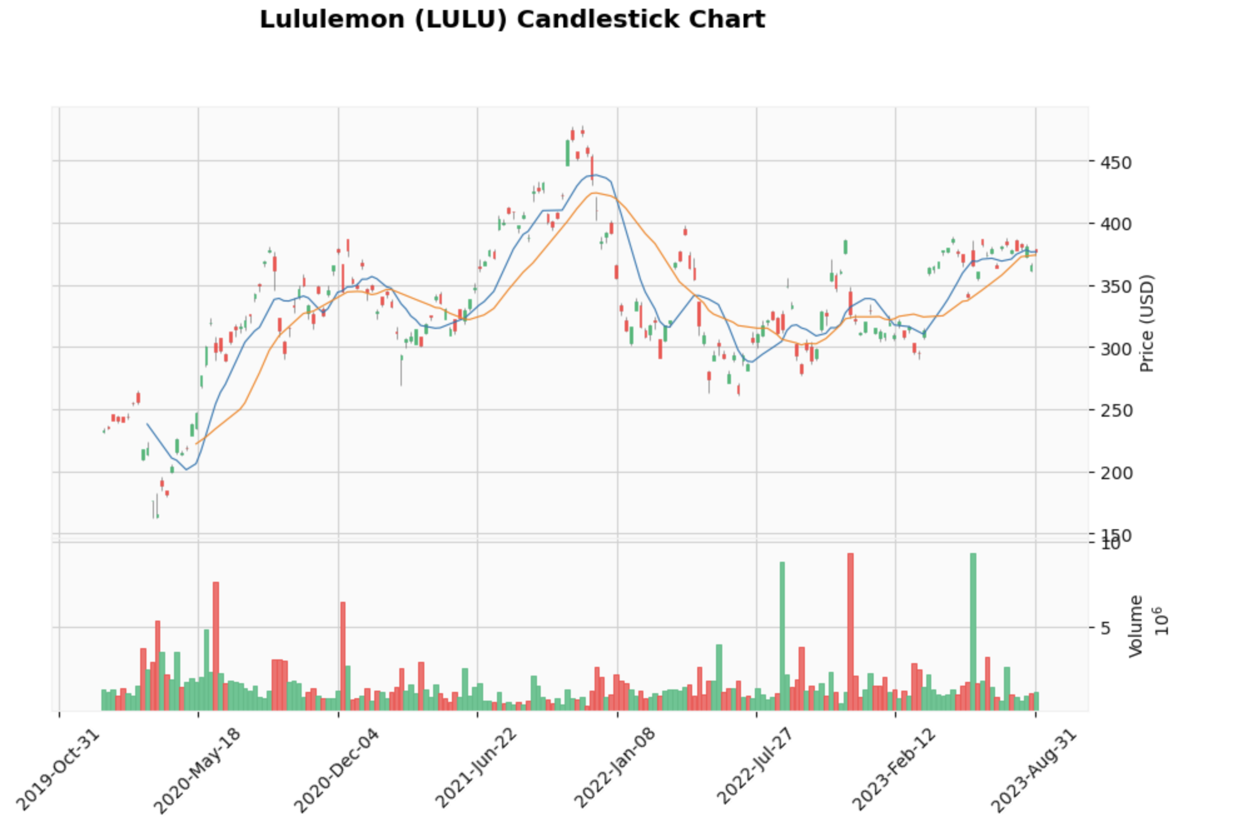
Stocks of LULU
Analysis Focus Period:
Jan 01’20 - Aug 31 ’23
On an average,
Average High Price for LULU: $336.91
Average Low Price for LULU: $326.89
Average Close Price for LULU: $332.04
Average Open Price for LULU: $332.13

Slide 4
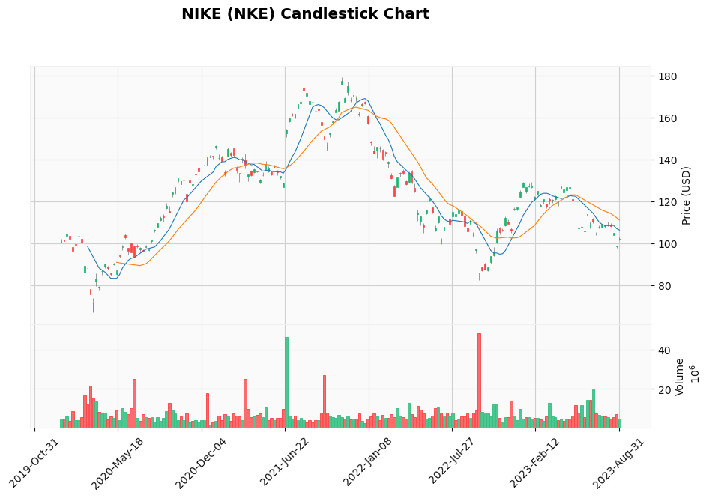
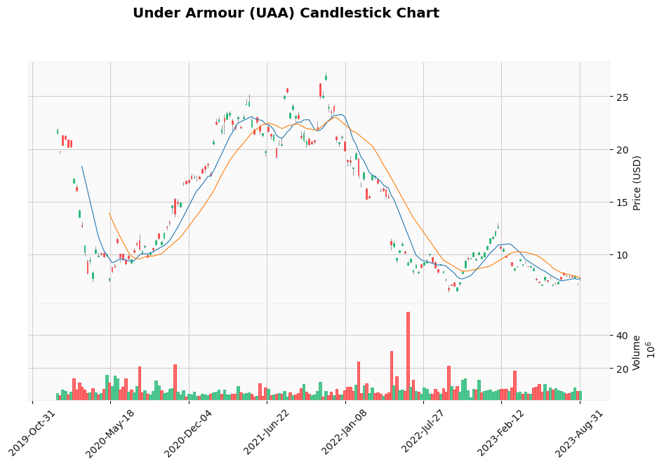
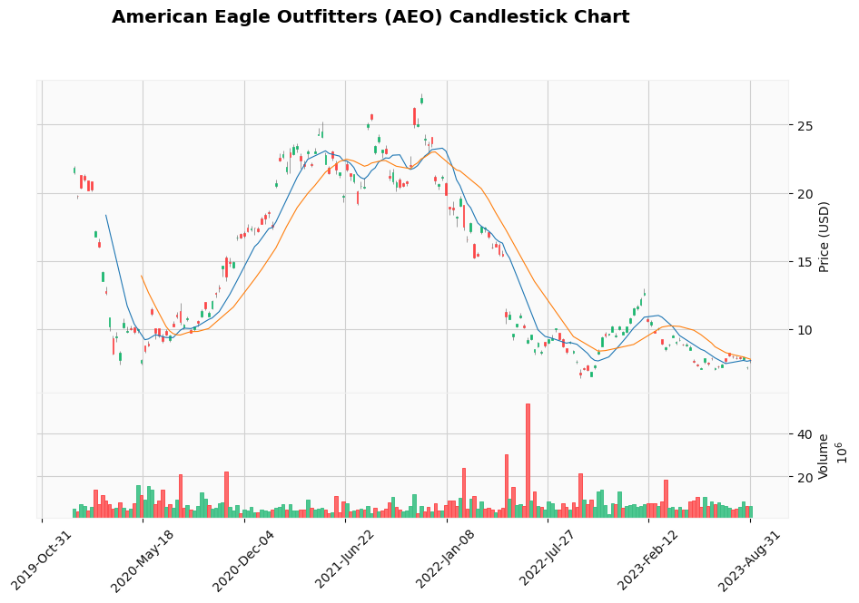
Stocks of competitors Analysis Focus Period: Jan 01 ’20 - Aug 31 ’23
Average High Price for NKE: $124.51
Average Low Price for NKE: $121.70
Average Close Price for NKE: $123.11
Average Open Price for NKE: $123.13
Average High Price for UAA: $14.66
Average Low Price for UAA: $14.09
Average Close Price for UAA: $14.36
Average Open Price for UAA: $14.38
Average High Price for AEO: $18.46
Average Low Price for AEO: $17.66
Average Close Price for AEO: $18.06
Average Open Price for AEO: $18.06

Slide 5
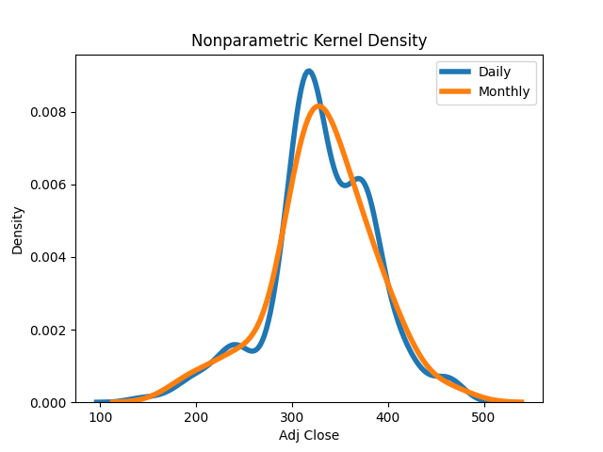
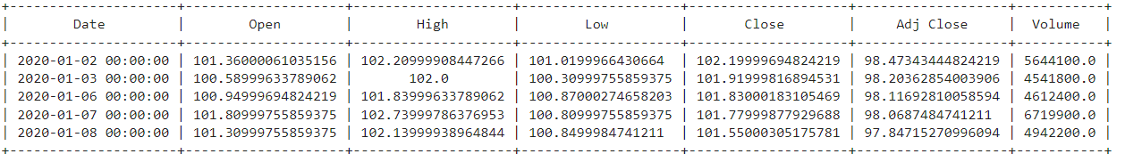
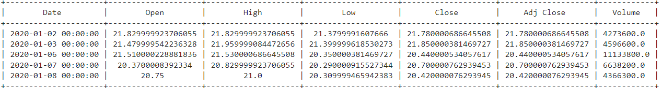
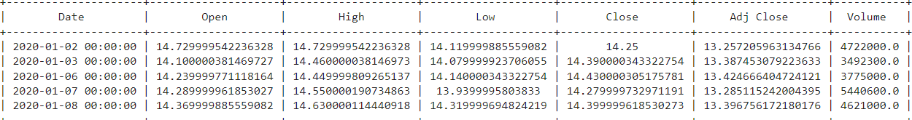
KERNEL DENSITY
NKE
UAA
AEO

Slide 6
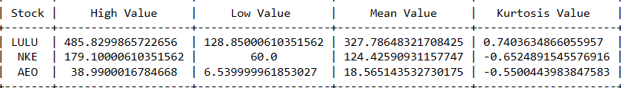
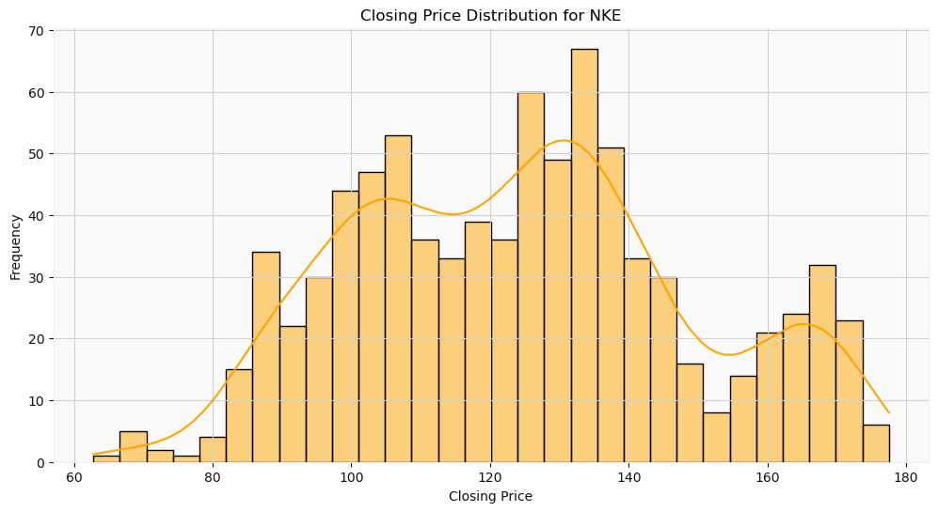
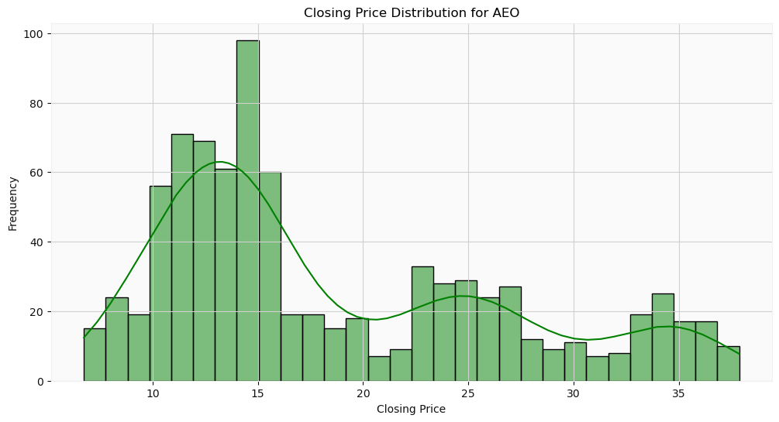
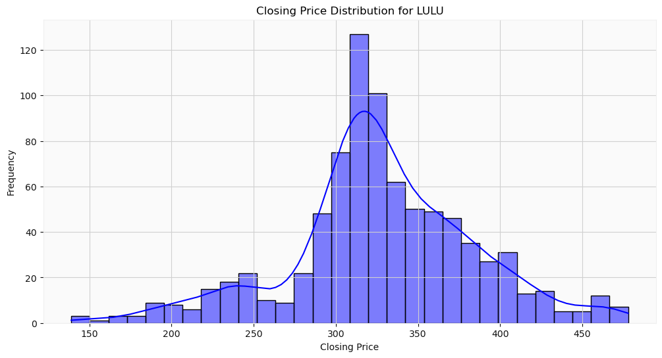
Exploratory data Analysis
Kurtosis is a statistical measure used to describe a characteristic of a dataset.
Types:
Mesokurtic (Kurtosis = 3.0), moderate level of risk.
Leptokurtic (Kurtosis > 3.0), high level of risk
Platykurtic (Kurtosis < 3.0), less than moderate risk

Slide 7
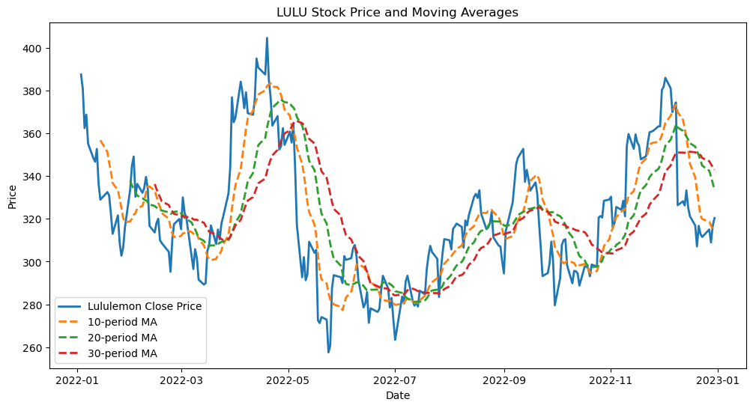
Exploratory data Analysis
Golden Cross Cheat Sheet:
When a short-term moving average crosses above a long-term moving average.
Suggests a potential upward trend in price
Death Cross Cheat Sheet:
When a short-term moving average crosses below a long-term moving average.
Suggests a potential downward trend in price.
Death Cross
Golden Cross

Slide 8
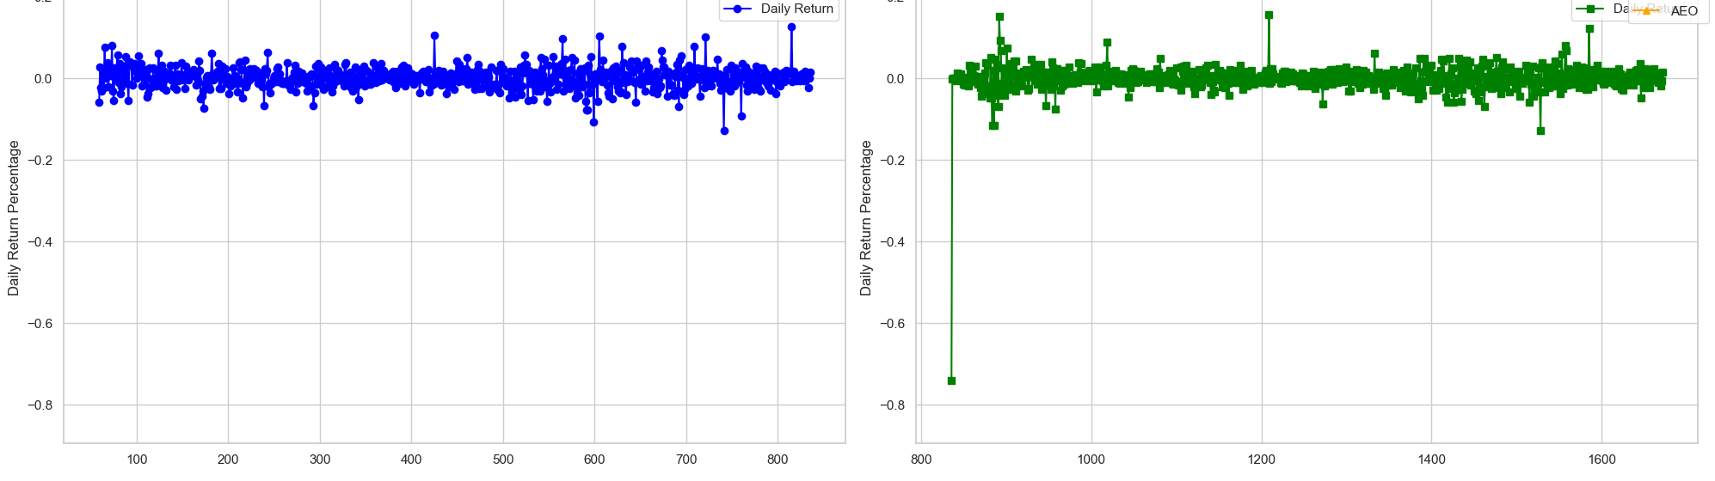
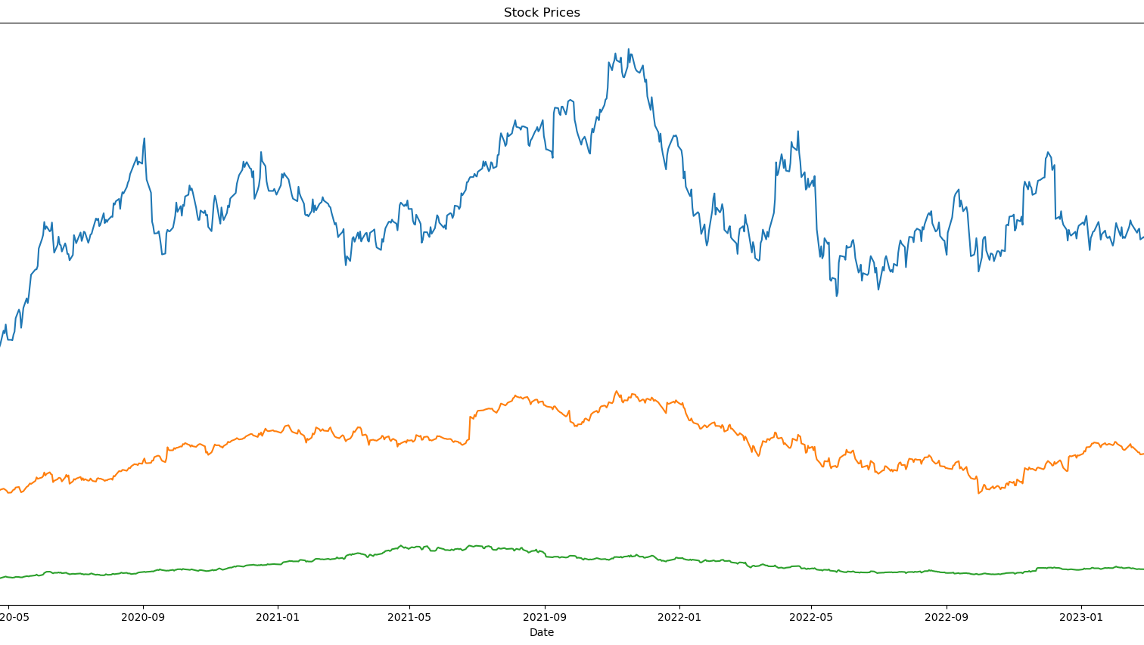

Slide 9
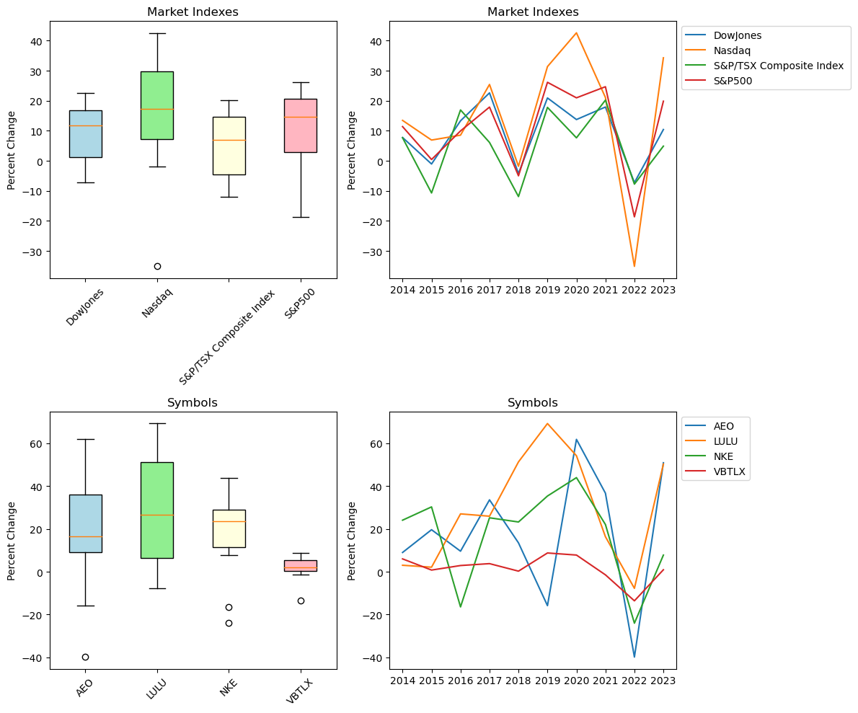
Exploratory data Analysis
RETURNS FROM 2014 TO 2023:
DowJones 94.36%
Nasdaq 146.96%
S&P/TSX Composite Index 51.10%
S&P500 107.87%
AEO 178.95%
LULU 291.65%
NKE 171.43%
VBTLX 16.13%

Slide 10
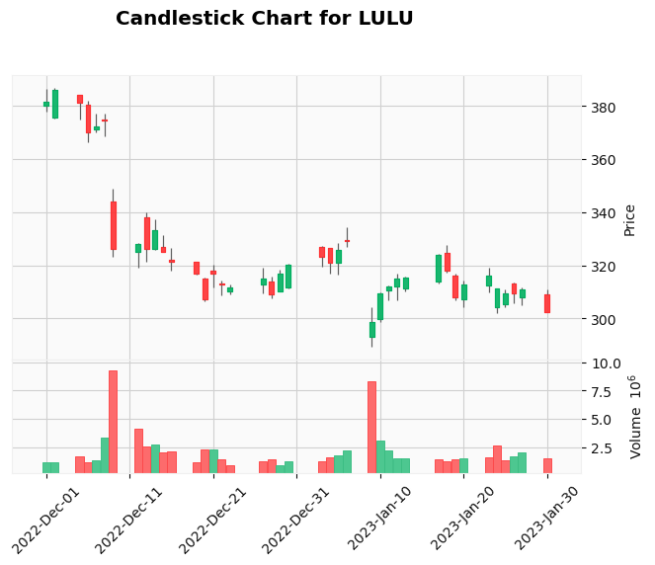
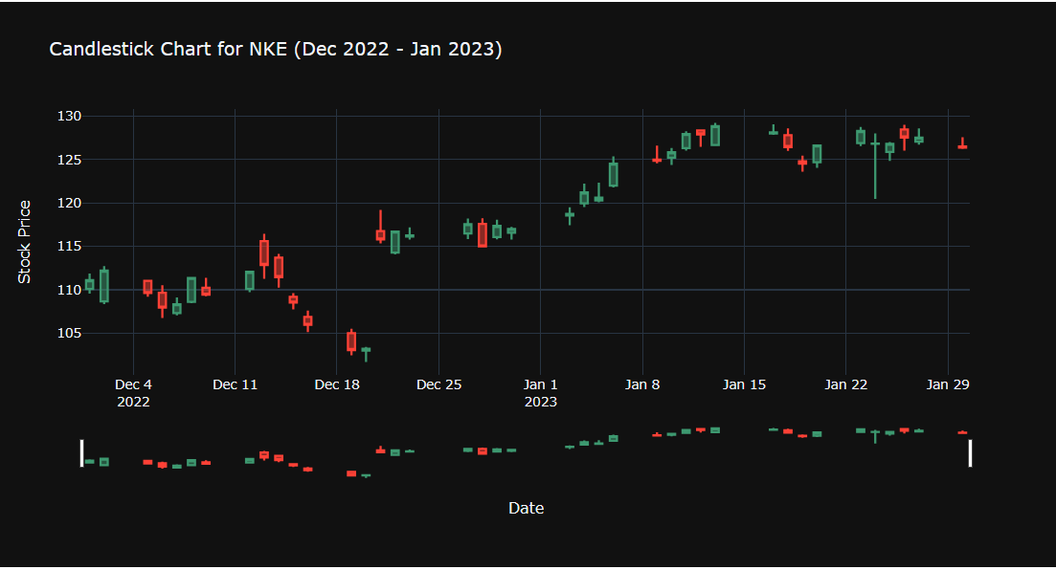
Exploratory data Analysis
In this analysis, we aim to investigate the impact of New Year resolutions on fitness wear stocks through sentiment analysis.
The objective is to uncover insights into public perceptions and sentiments during the New Year period, with a specific focus on how these sentiments might influence the stock prices of companies in the fitness wear industry.

Slide 11
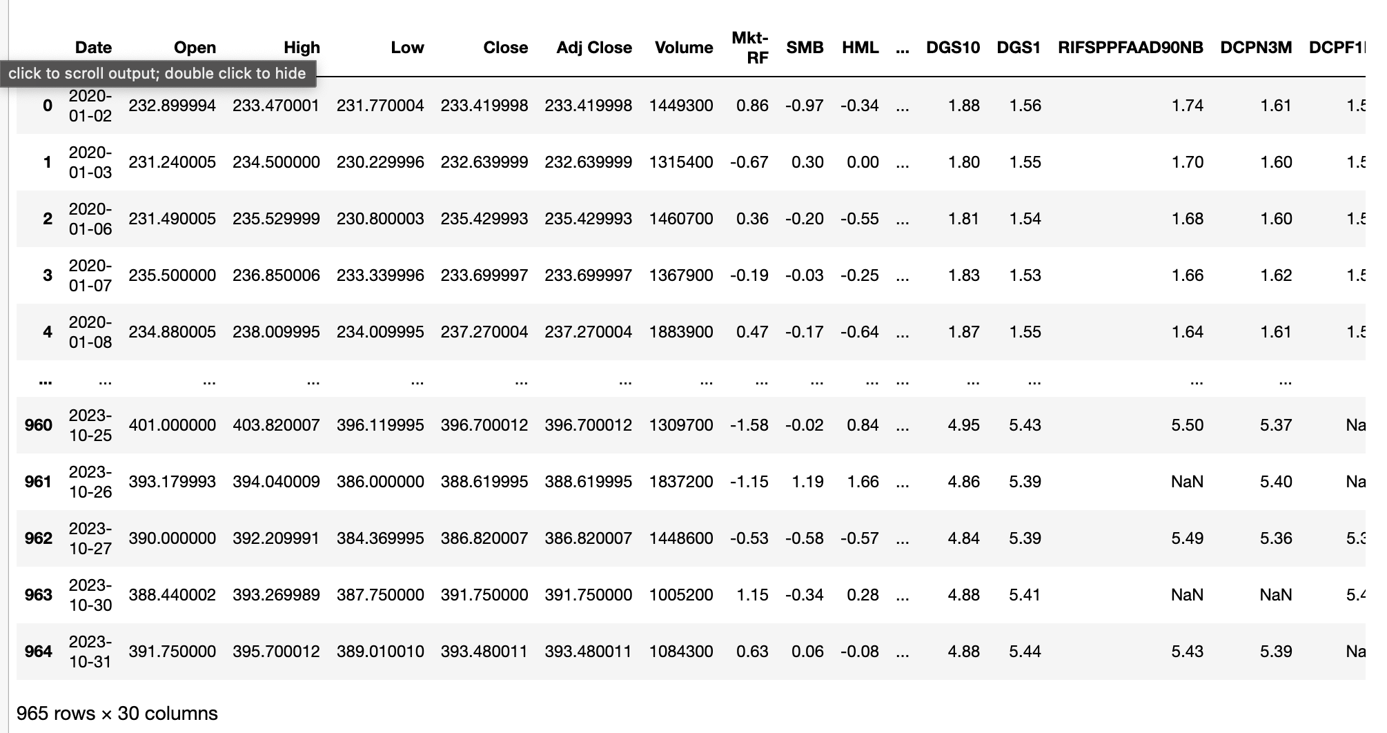
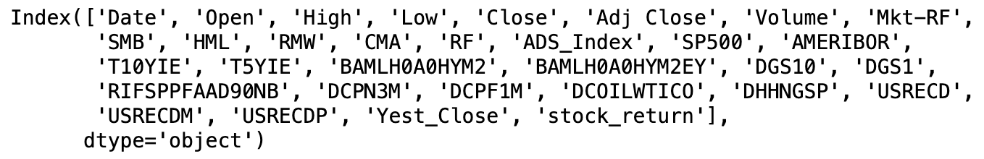
Data PRe-processing
We have used:
Fama – French
Fred
ADS
Features used:

Slide 12
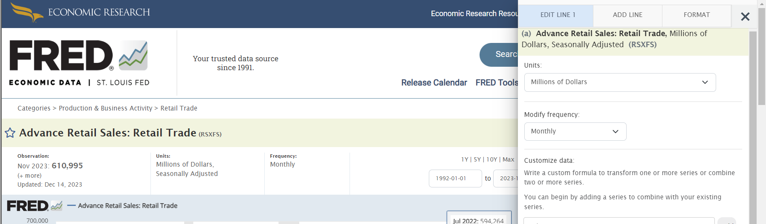
Data PRe-processing
DEXUSEU: U.S. / Euro Foreign Exchange Rate (Exchange Rates)
CPIAUCNS: Consumer Price Index for All Urban Consumers (Inflation)
PPIACO: Producer Price Index by Commodity for All Commodities (Producer Prices)
RSXFS: Retail Sales Index (Retail Sales)
M2: M2 Money Stock (Money Supply)
PAYEMS: All Employees, Total Nonfarm (Employment Level)
IC4WSA: Initial Claims (4-week average) (Initial Jobless Claims)
UMCSENT: University of Michigan: Consumer Sentiment (Consumer Sentiment)
GDPC1: Real Gross Domestic Product (GDP)

Slide 13
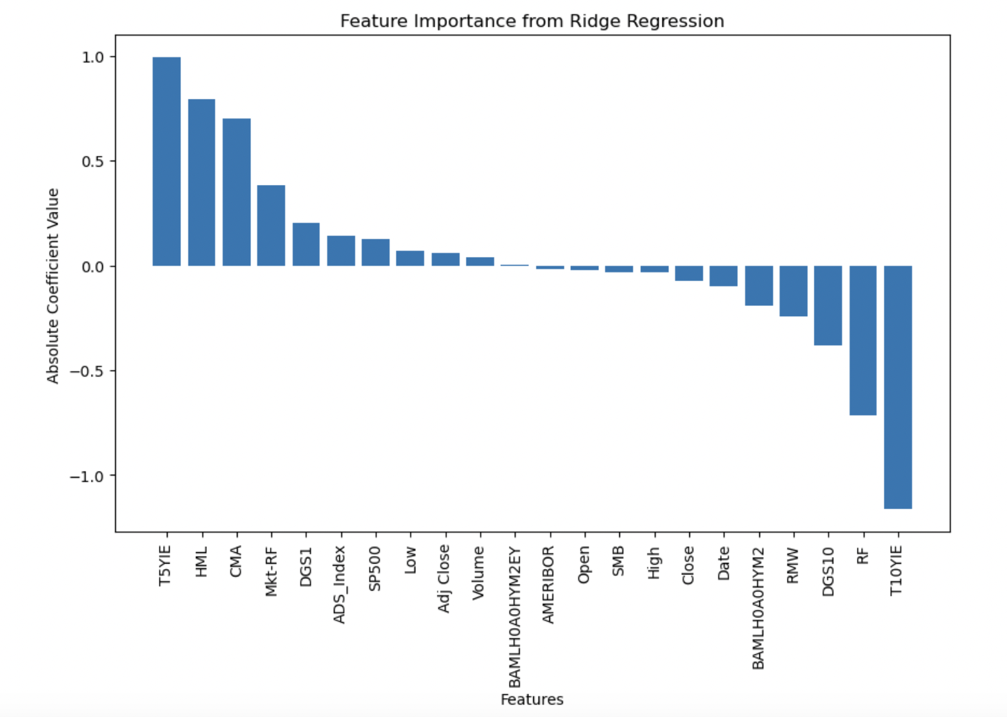
RIDGE REGRESSION
One of the most basic models of linear regression.
Captures the relationship between dependent variable and independent variable(s)
Mathematically representation,
y = mx + c
Feature importance, employing features to determine the value of 'm'.

Slide 14
RIDGE REGRESSION
Best alpha value: 0.01274274985703134
RMSE Value: 0.5891040722044097
Average magnitude of the errors between the actual and predicted values
Mean Cross-Validation Score: -0.9758069052087253 Average performance of the Ridge Regression model across multiple folds, with a lower value indicating better predictive accuracy using negative mean squared error as the evaluation metric.
MEAN of Mean Squared Error: 0.9758069052087253
Represents the average squared difference between predicted and actual values.
STD of RMSE Squared Error: 0.289072067079414
The variability or consistency of the model's performance across different folds during cross-validation. Root Mean Squared Error on Test Set: 0.9445868119146912
The average magnitude of the errors between the actual and predicted values, which gives an understanding of model's performance on unseen data

Slide 15
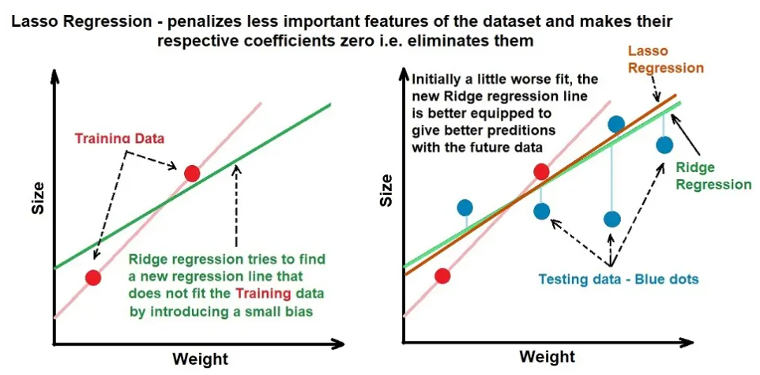
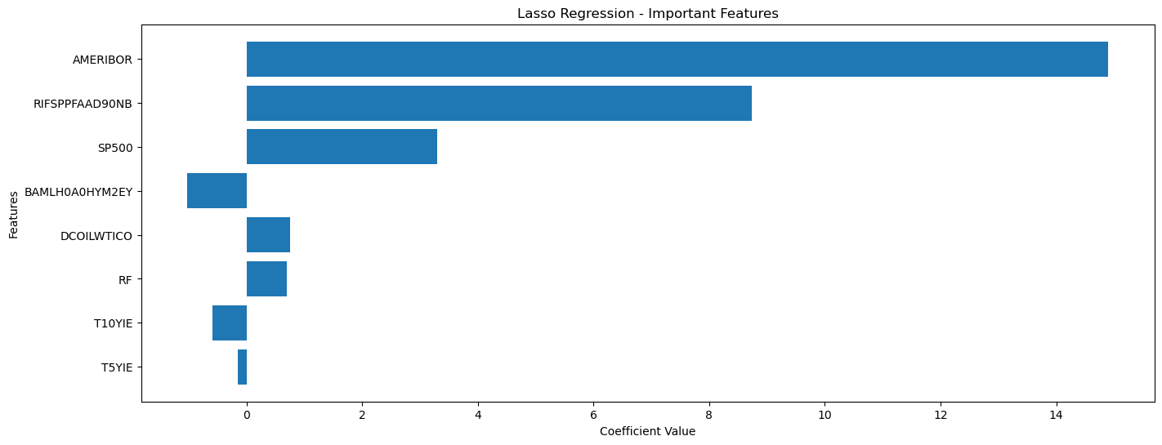
LASSO
LASSO regression offers a powerful framework for both prediction and feature selection, especially when dealing with high-dimensional datasets where the number of features is large.
By striking a balance between simplicity and accuracy, LASSO can provide interpretable models while effectively managing the risk of overfitting.
The linear regression equation can be represented as follows
y = β₀ + β₁x₁ + β₂x₂ + ... + βₚxₚ + ε Where:
y is the dependent variable (target).
β₀, β₁, β₂, ..., βₚ are the coefficients (parameters) to be estimated.
x₁, x₂, ..., xₚ are the independent variables (features)

Slide 16
LASSO
After multiple trial and errors:
The best hyperparameters are {'alpha': 1.5127782816797033}
The RMSE represents the average magnitude of the errors between the actual and predicted values.
RMSE: 14.99178208802605
By RMSE in this case, we can say that the on average, the model's predictions deviate by around 15 units from the actual values.
Mean Cross-Validation Score: -493.4662321247396 MEAN of Mean Squared Error: 493.4662321247396 The mean of the mean squared error (MSE) is approximately 493.47. This represents the average squared difference between predicted and actual values. STD of RMSE Squared Error: 4.7886047683680575 The standard deviation of the root mean squared error (RMSE) is approximately 4.79. This indicates the variability or consistency of the model's performance across different folds during cross-validation. Root Mean Squared Error on Test Set: 21.69183017859725
The root mean squared error (RMSE) on the test set is approximately 21.69. This is the average magnitude of the errors between the actual and predicted values, providing an indication of the model's performance on unseen data.

Slide 17
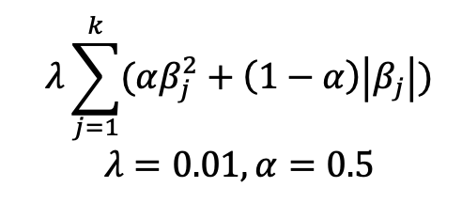
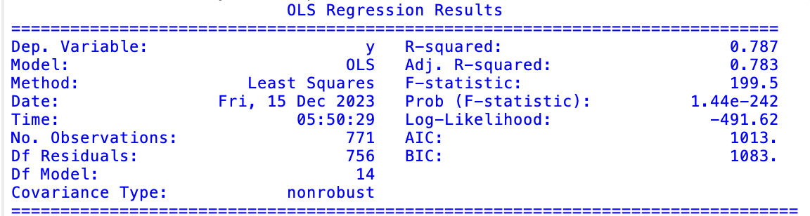
Elastic Net
Step1: Run Elastic Net and Obtain Coefficients
Step2: Remove features with coefficients close to 0 and run OLS

Slide 18
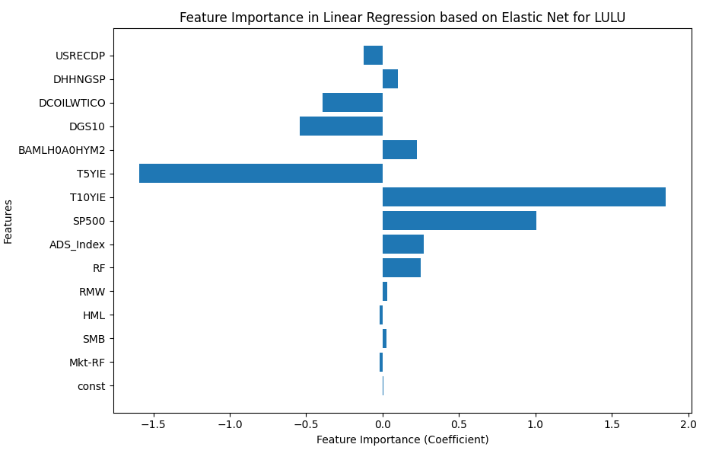
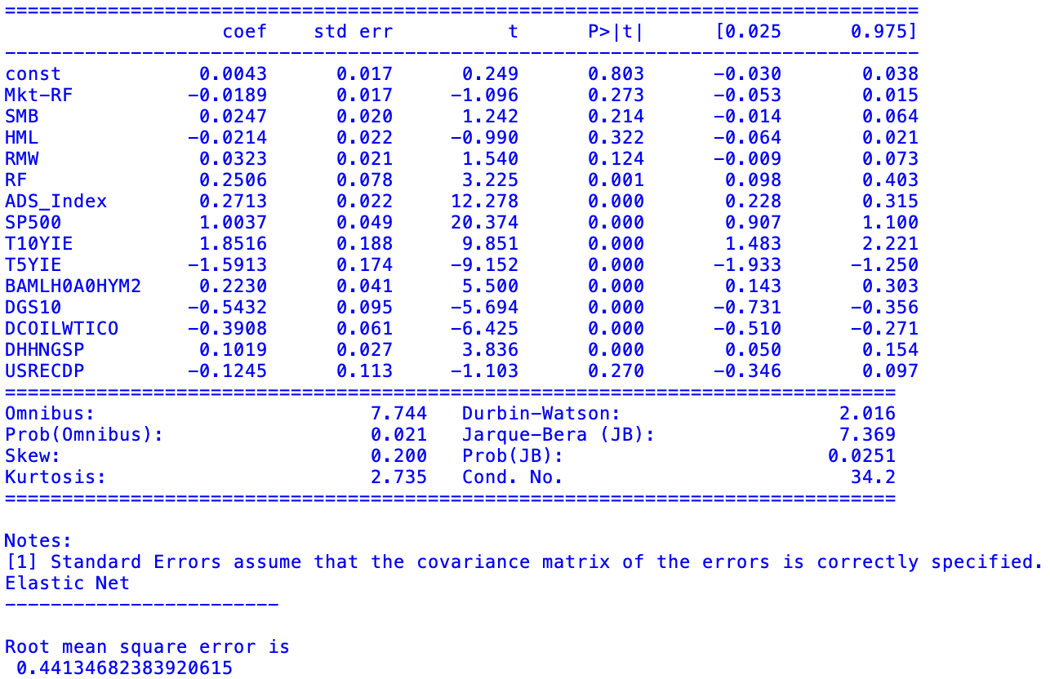
Elastic Net

Slide 19
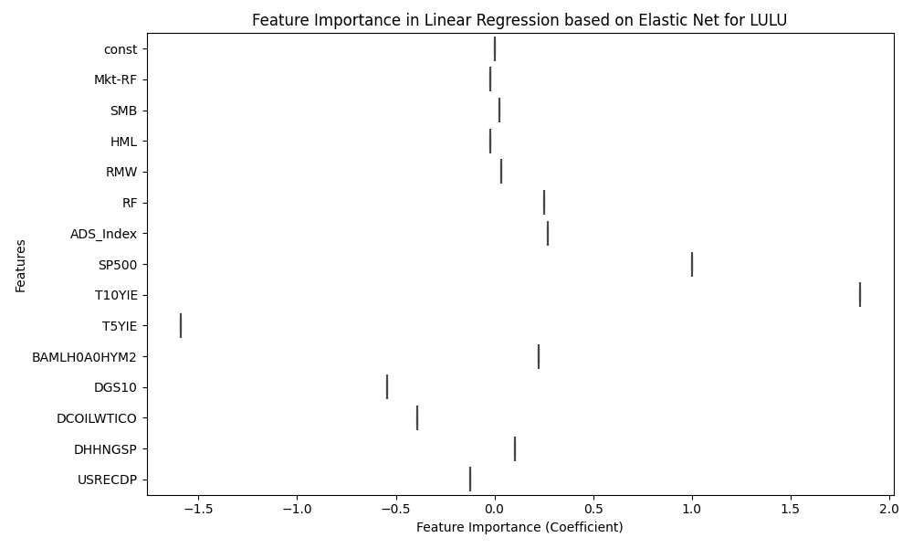
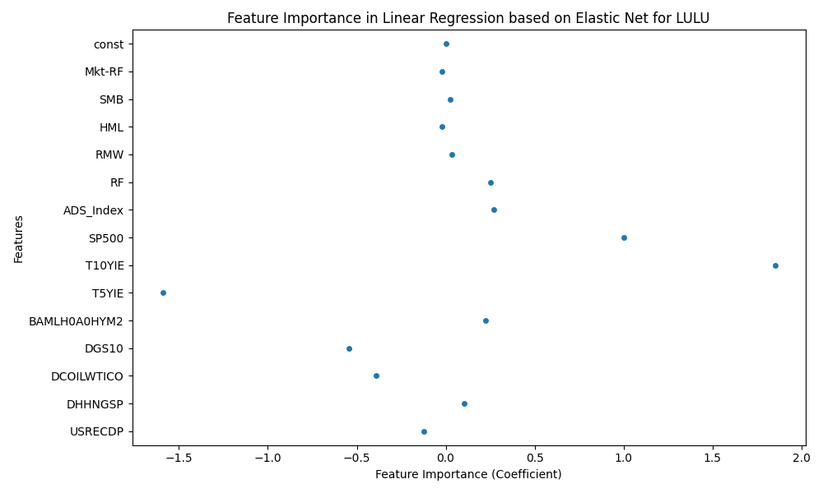
Elastic Net

Slide 20
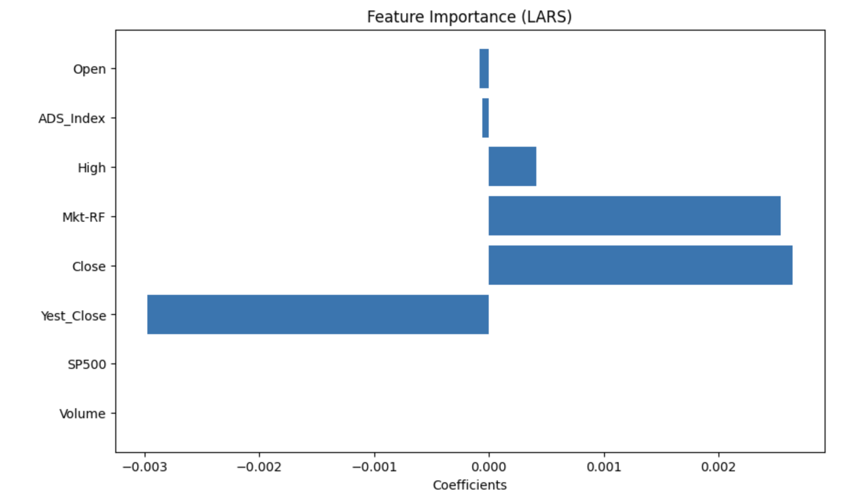
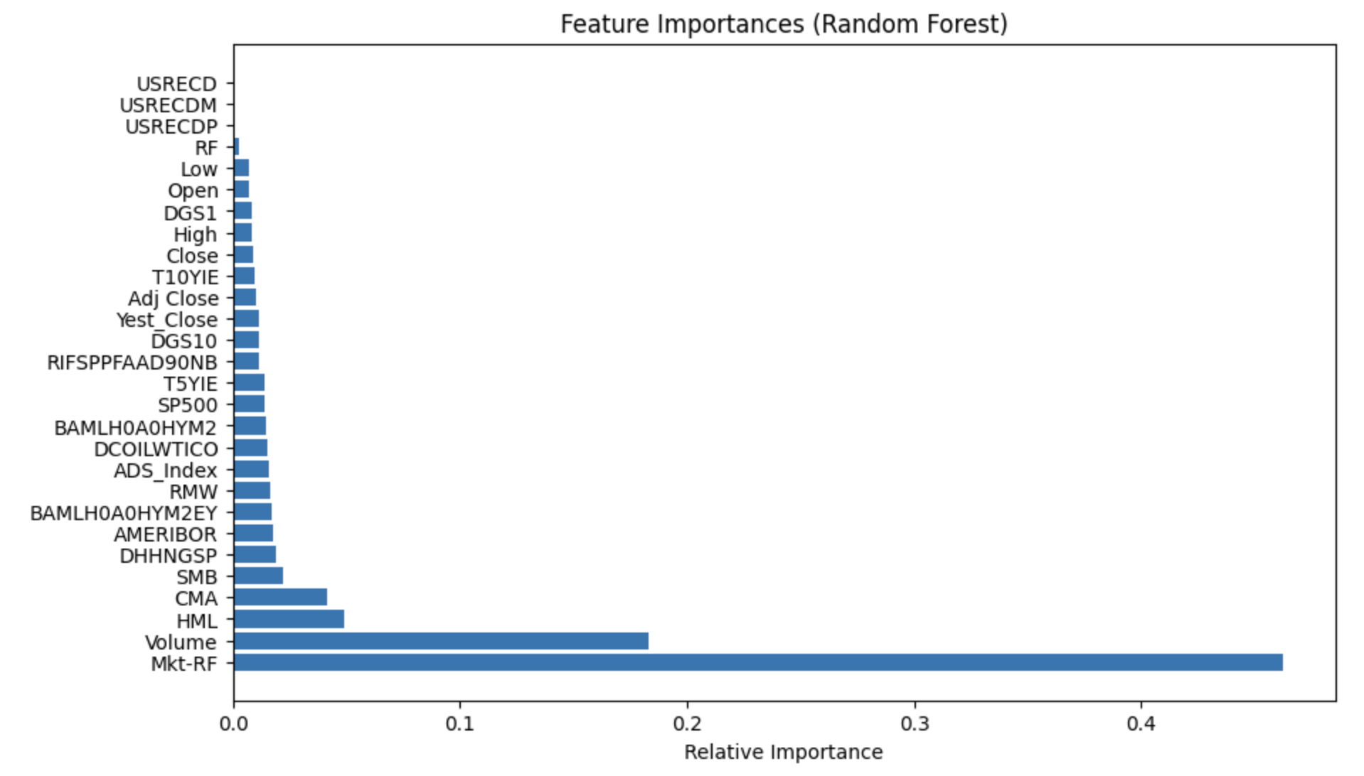
LARS
Mean Cross-Validation Score (LARS): 0.010625557575596233 STD of RMSE (Cross-Validation, LARS): 0.02045888504668337
Root Mean Squared Error on Test Set (LARS): 0.03208367771025552
Mean Cross-Validation Score (Random Forest): 0.04168947461545898 STD of RMSE (Cross-Validation, Random Forest): 0.019707610442369636
Root Mean Squared Error on Test Set (Random Forest): 0.02459708158748561

Slide 21
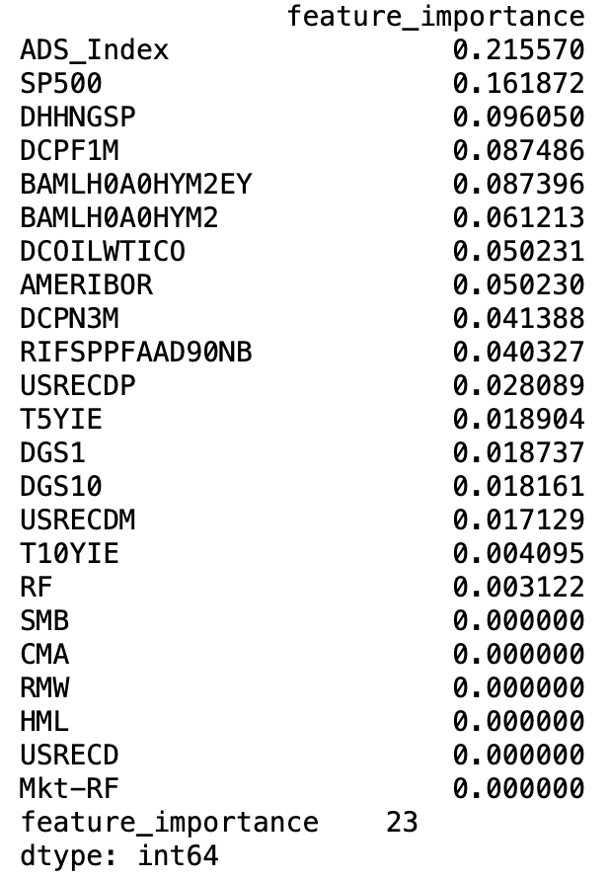
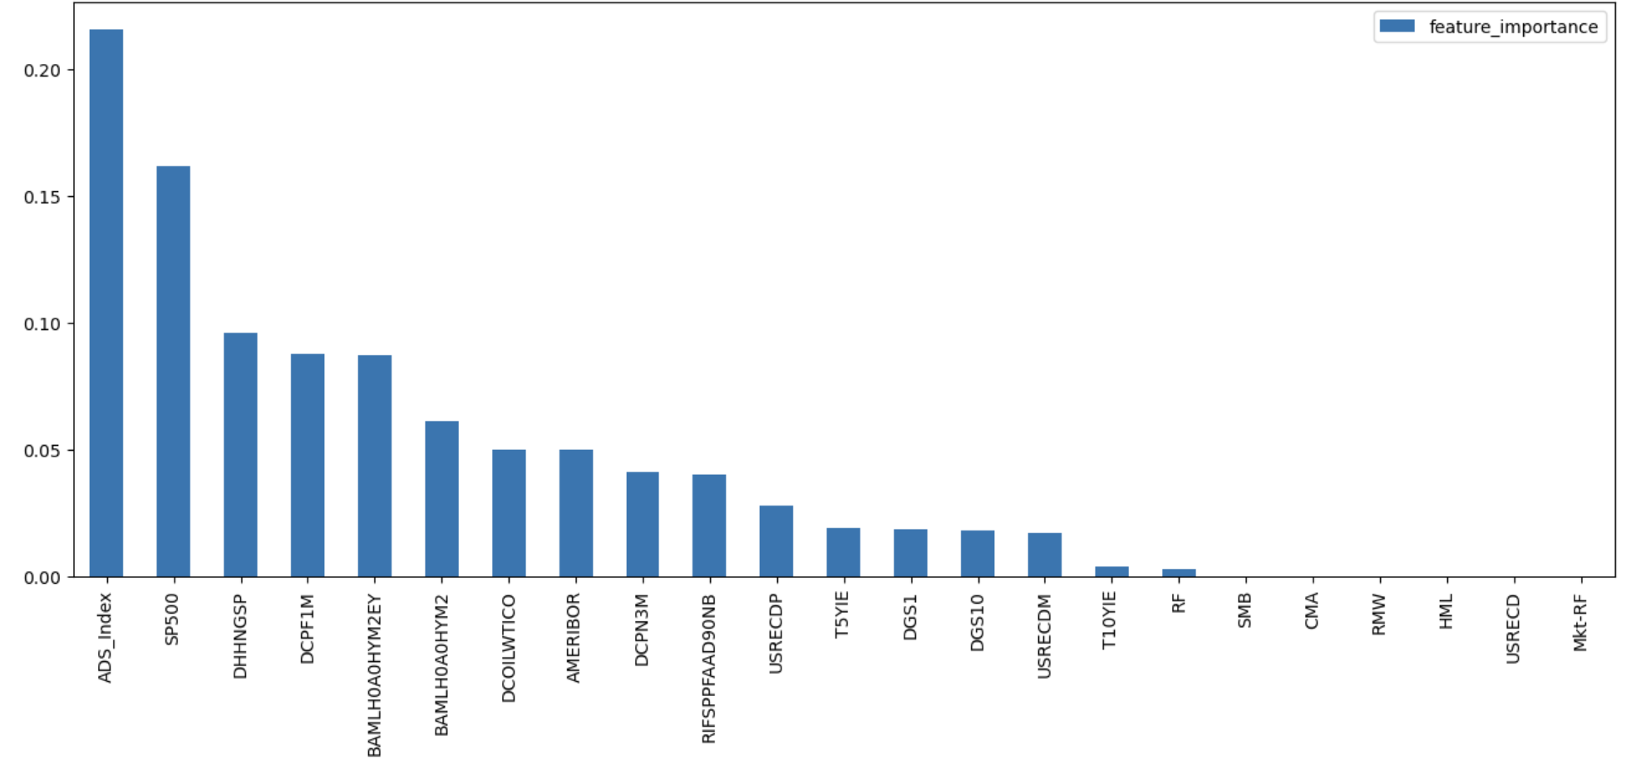
XGboost
Mean Cross-Validation Score: -2562.910990012464
MEAN of Mean Squared Error: 2562.910990012464
STD of RMSE Squared Error: 16.260633923676917
Root Mean Squared Error on Test Set: 47.94270303615172
Accuracy-
Root Mean Squared Error: 9.330181771443185

Slide 22
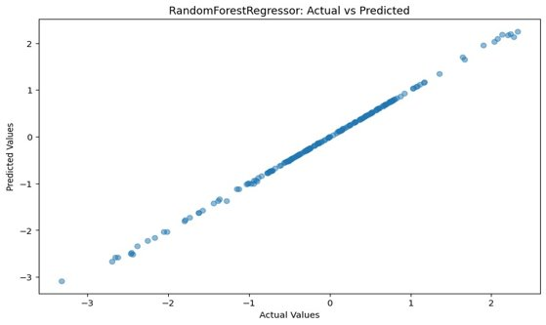
Random Forrest Regressor
The RandomForestRegressor model is a specific implementation of the random forest algorithm for regression tasks
The base models in a random forest are decision trees. Decision trees are built by recursively splitting the data based on the features to create a tree-like structure that makes predictions.
RandomForestRegressor is designed for regression tasks, where the goal is to predict a continuous output variable (e.g., predicting stock prices, housing prices).

Slide 23
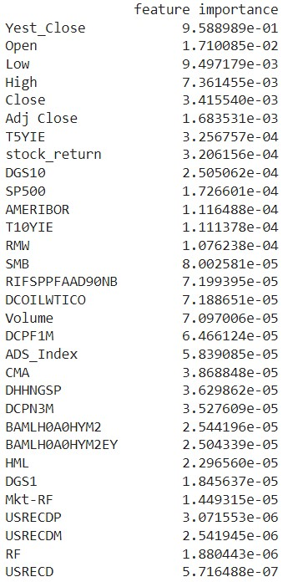
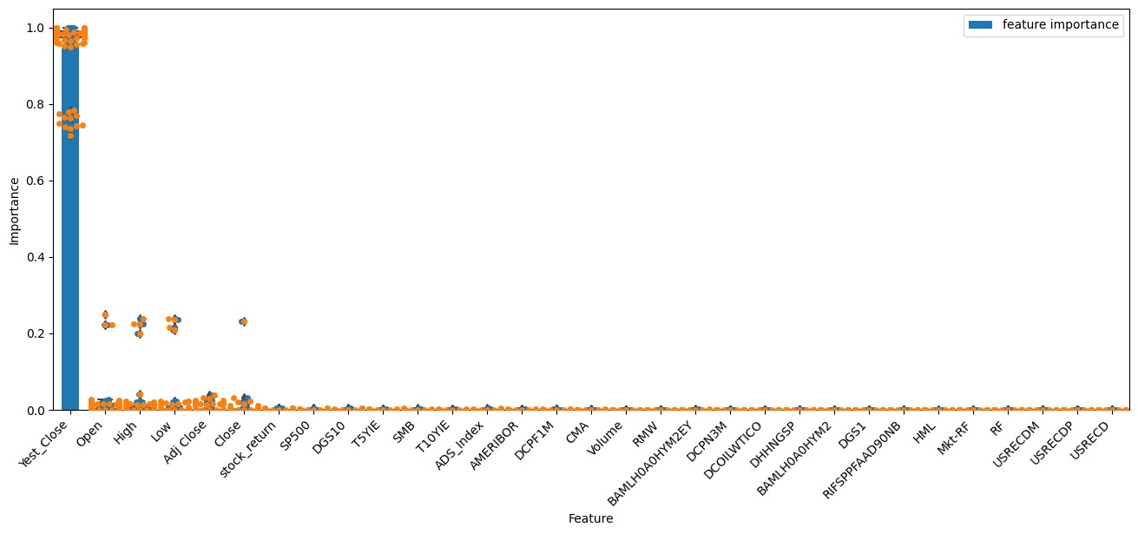
Random Forrest Regressor
Mean Squared Error: 0.000595421167789756
Root Mean Squared Error: 0.0244012534061215

Slide 24
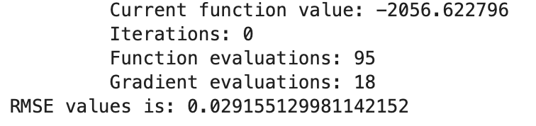
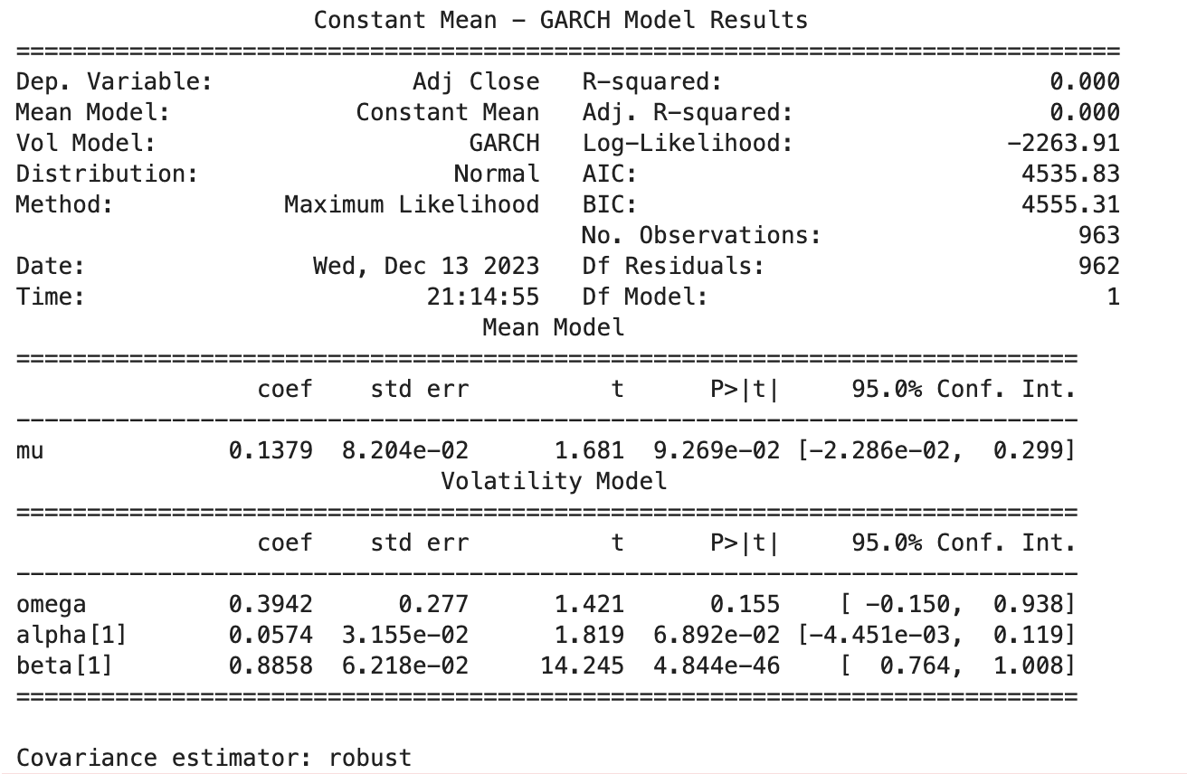
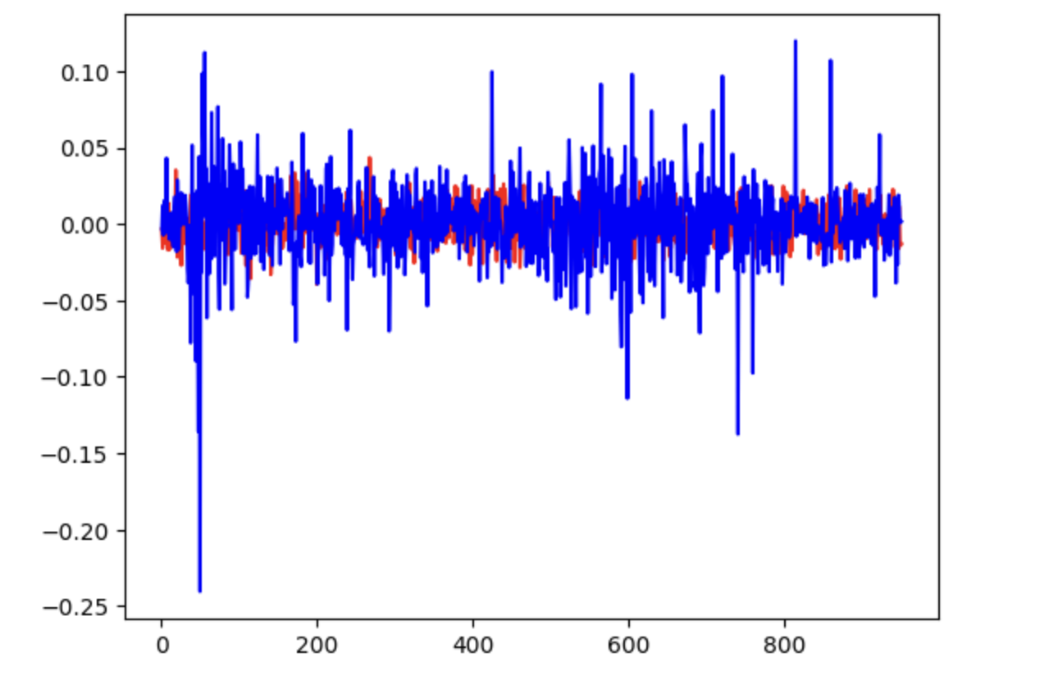
GARCH
The GARCH model is used to model financial time series data, particularly focusing on changing volatility over time, which is a common characteristic of stock market data.

Slide 25
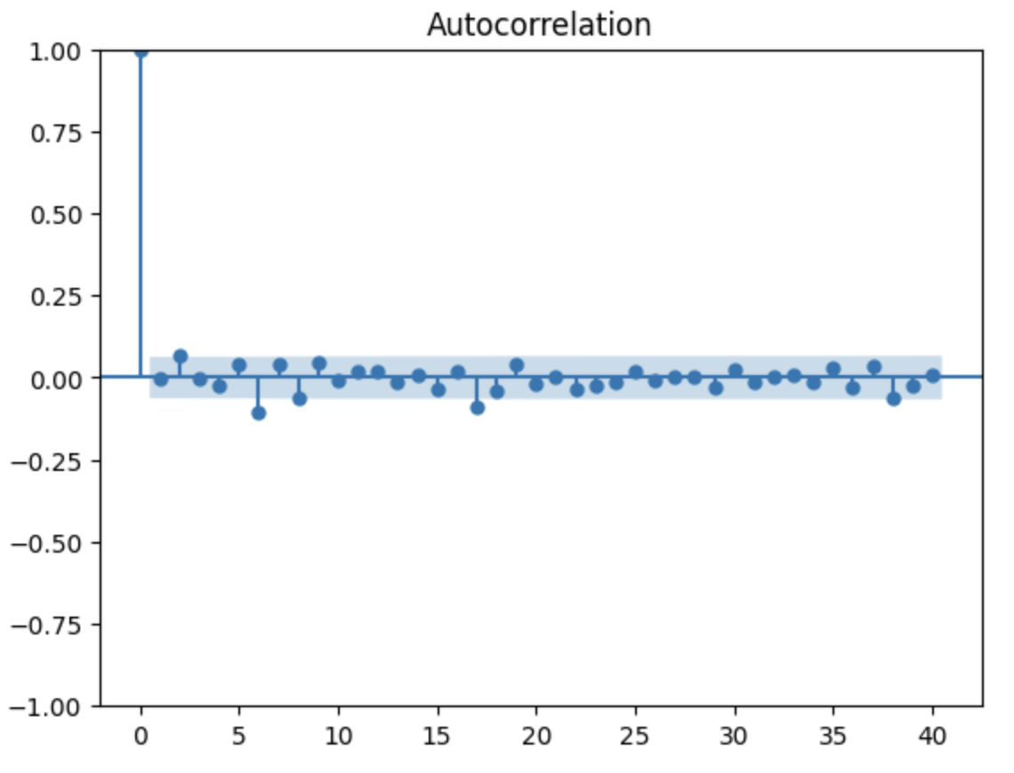
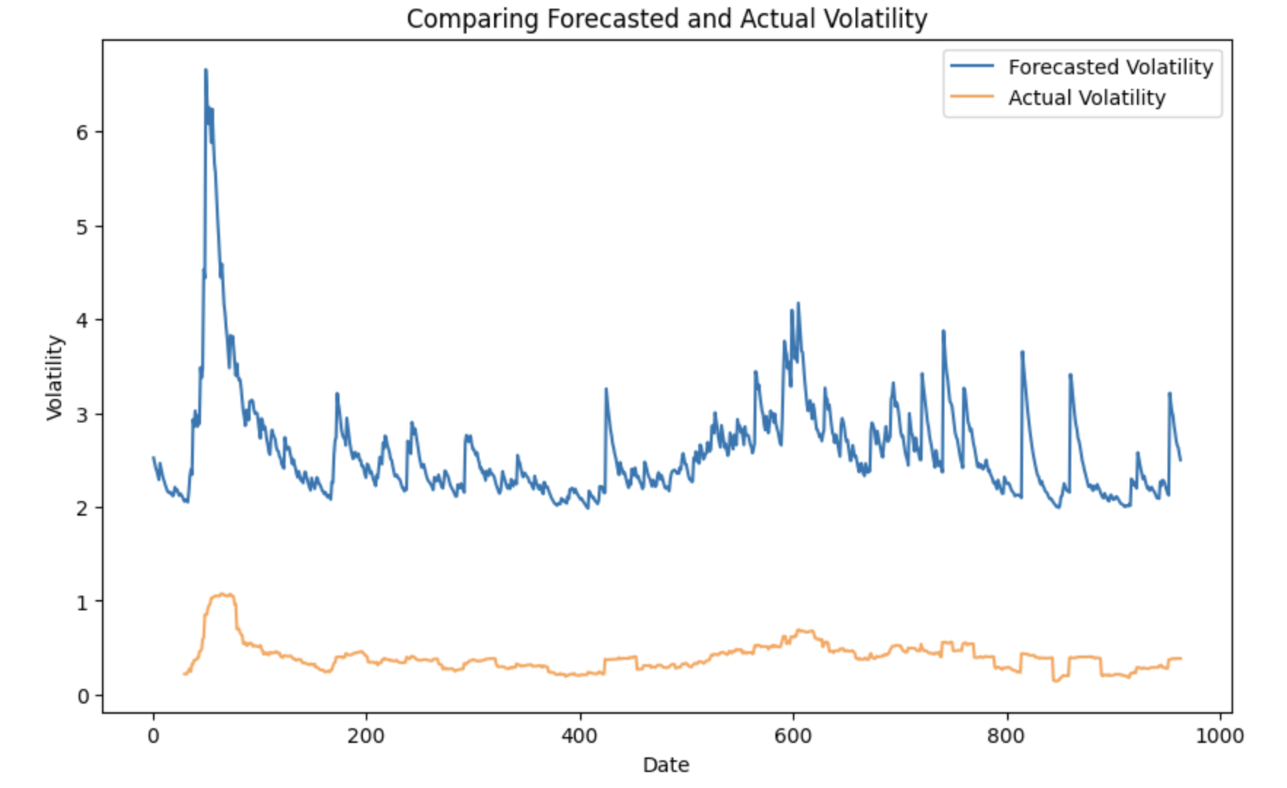
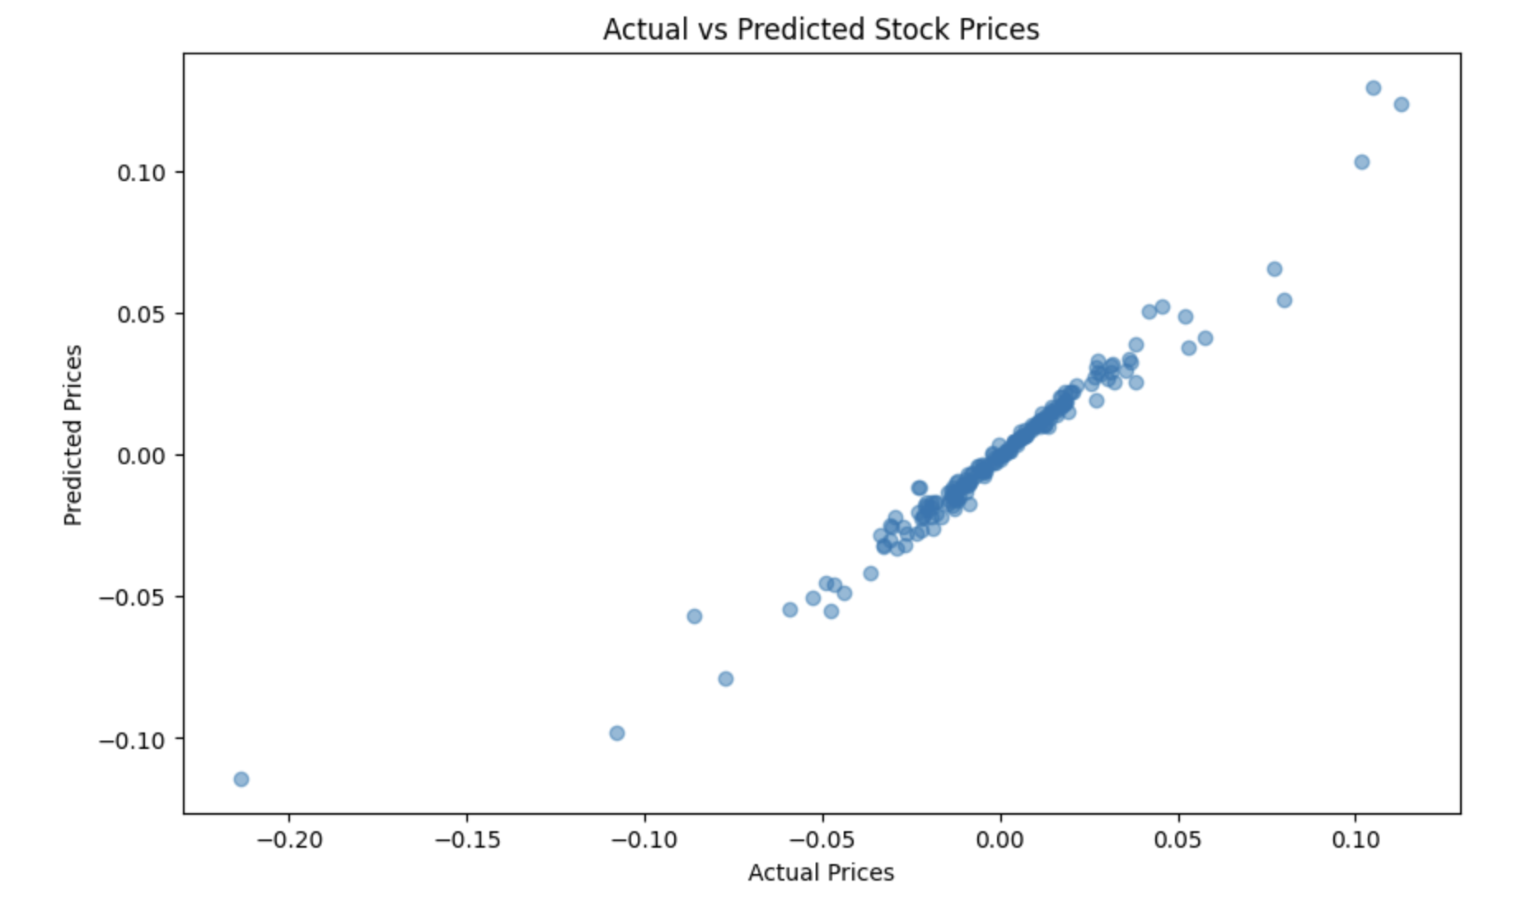
Using the fitted GARCH model to forecast future volatility. This can be useful for risk management and derivative pricing.

Slide 26
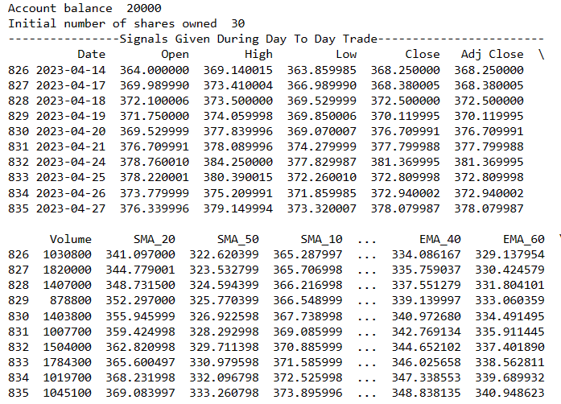
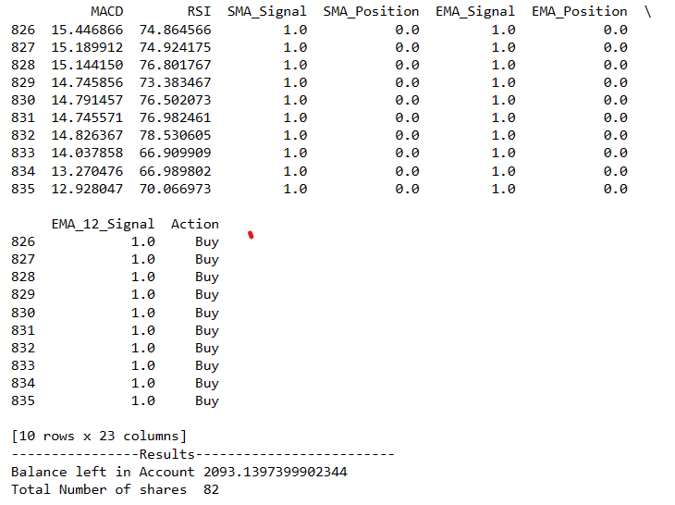
TRADING SIGNALS

Slide 27
Thank you!

